Slide 1
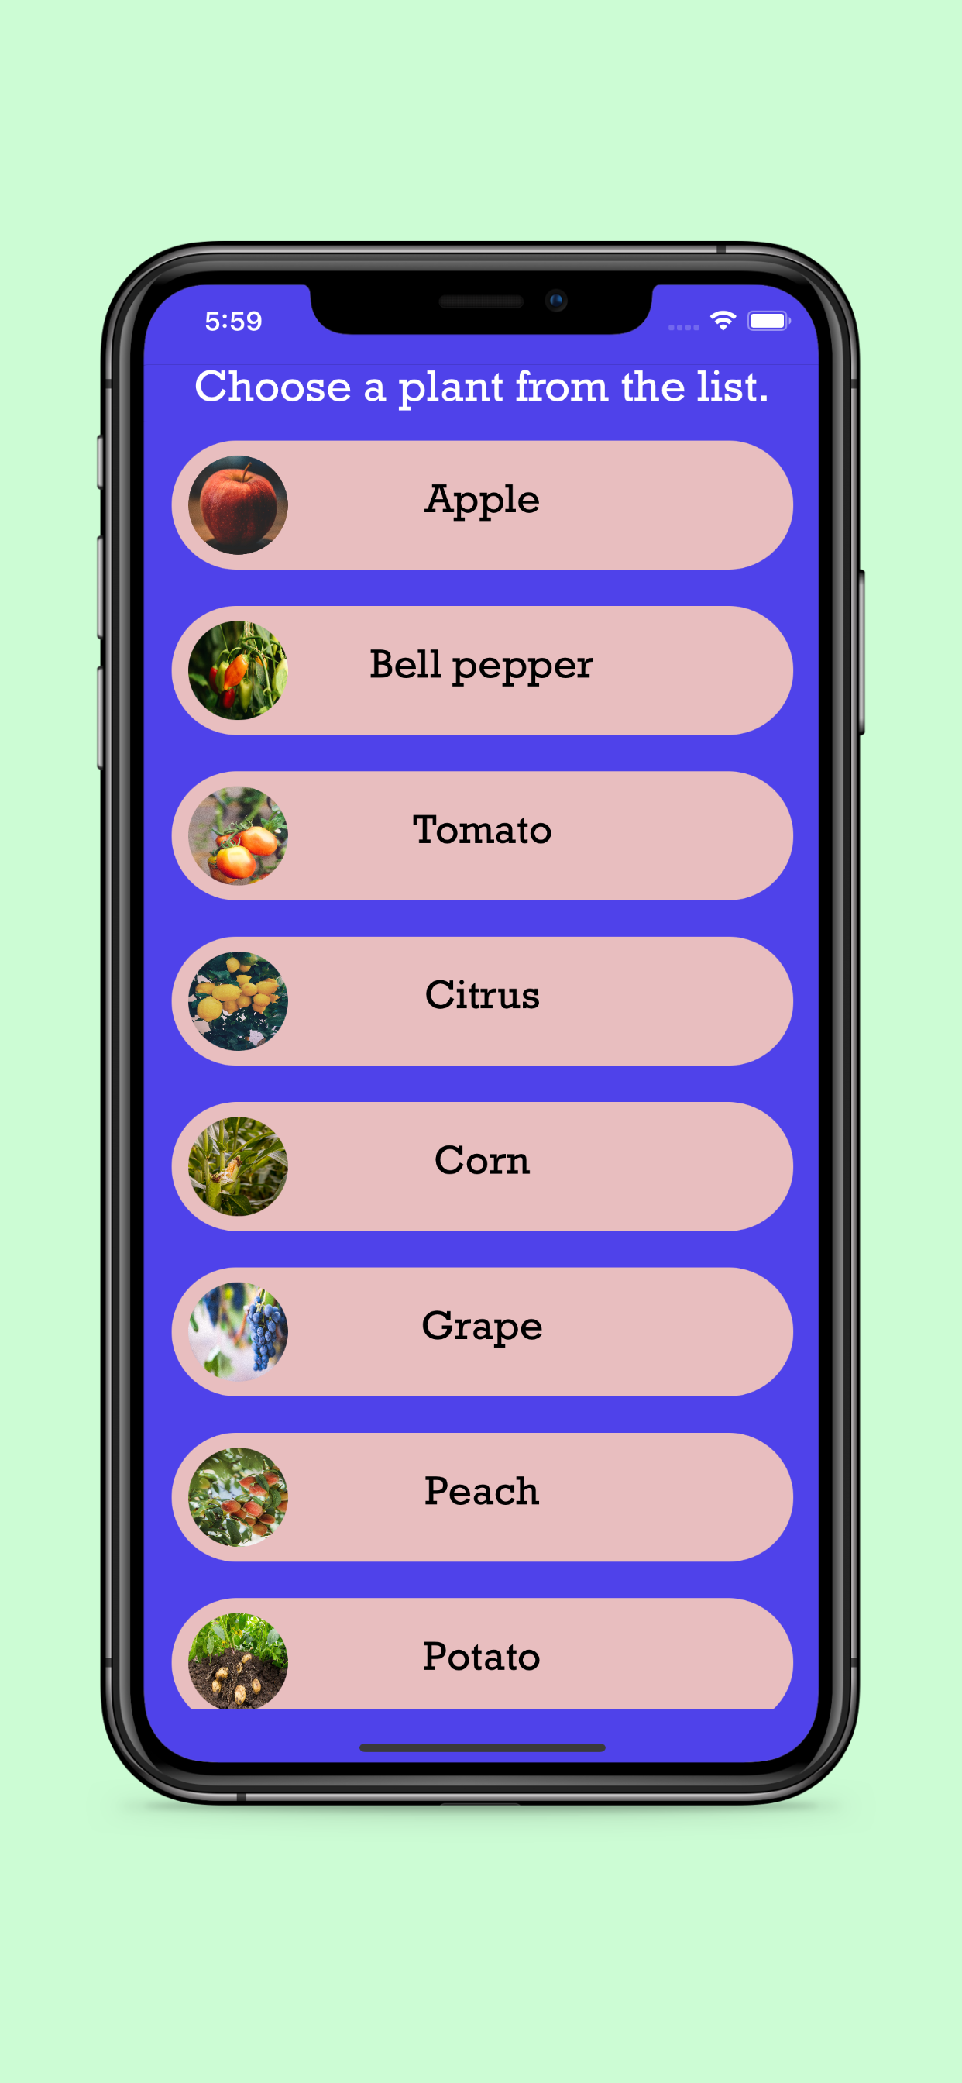
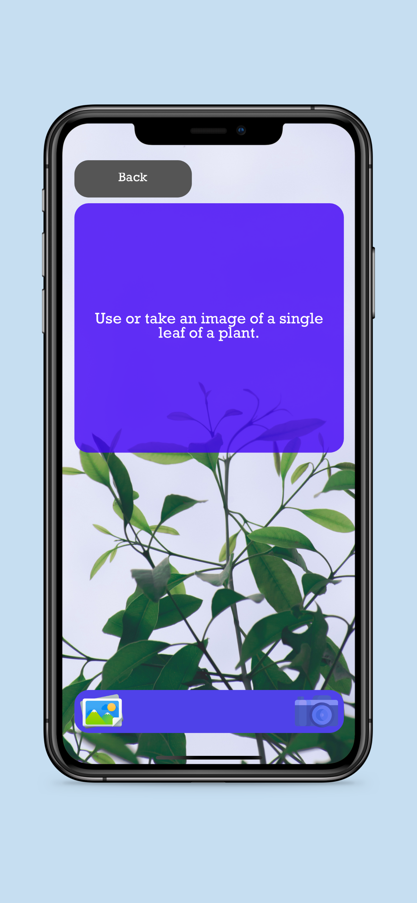
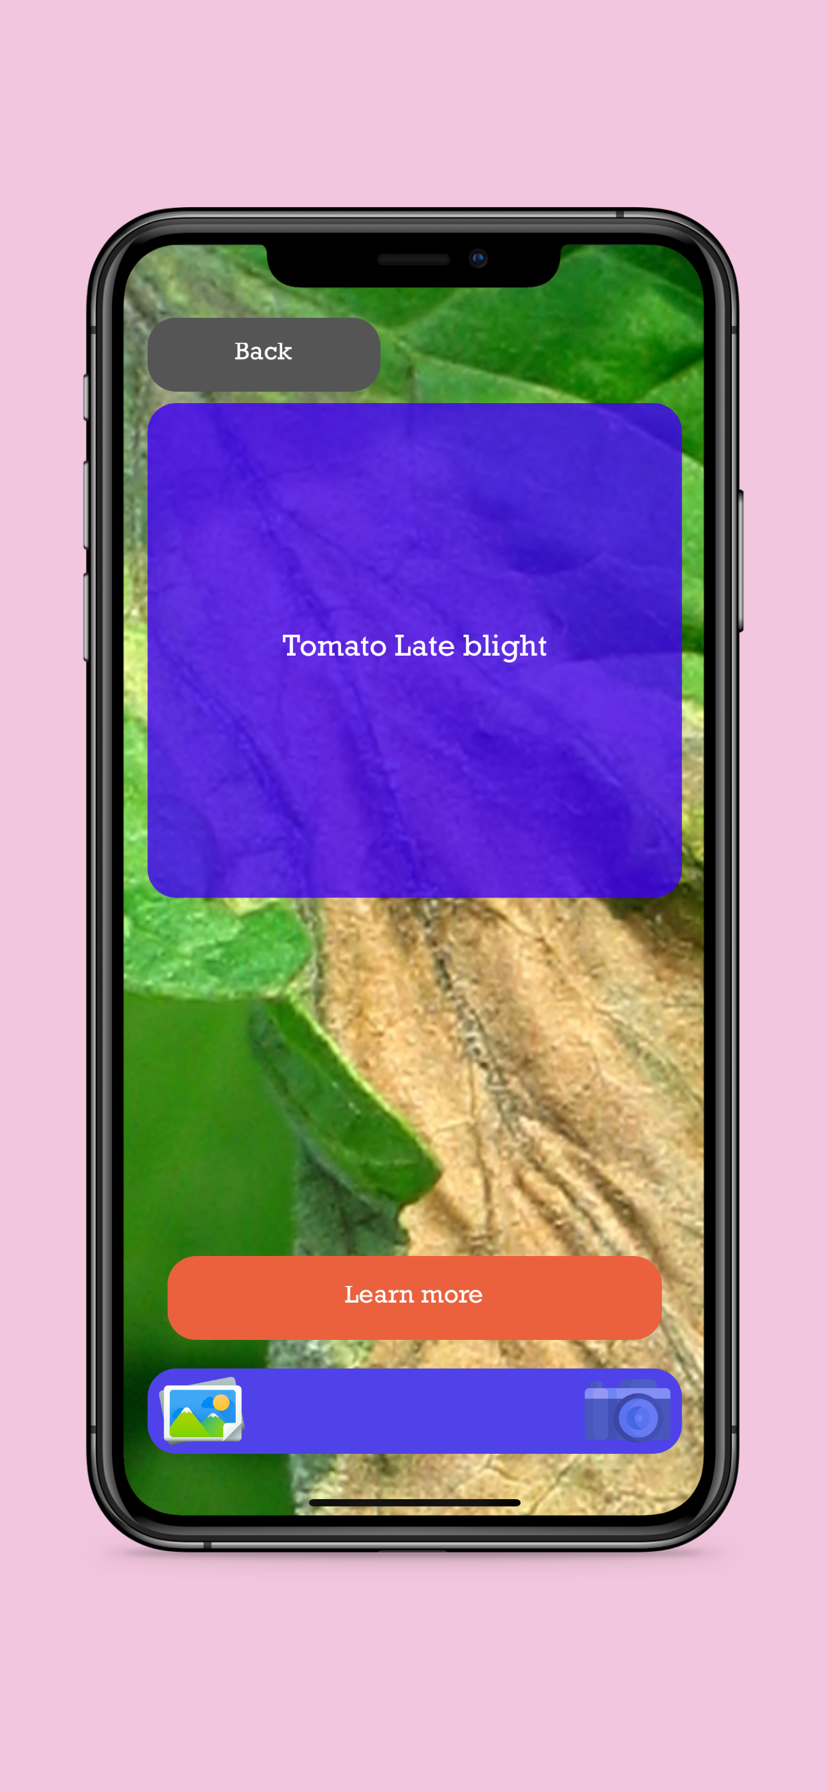
PlantifyDr A Mobile Application Utilizing 2D Convolutional Neural Networks to Diagnose Crop Diseases Through Image Classification of Plant Leaves
Alex Lavaee
Anie Robinson
Sage Hill School

Slide 2
Abstract
My plant disease detection uses machine learning to detect patterns in plant leave pictures to find common plant diseases and their treatment. My goal is to address food insecurity by providing information to educate the public and farmers. After working for 3 months, I collected data over 125,000 leaf images from open-source databases and conducted experiments to get an overall accuracy of 99.2% for each of my 10 plants. My app was published on the App Store and Google Play Store for free and has over 1,000 downloads. After its release I quickly contacted local farmers, people interested in gardening, and universities. This allowed me to get lots of feedback and to improve my knowledge to build an upgraded version of my app which is currently in the App Store.

Slide 3
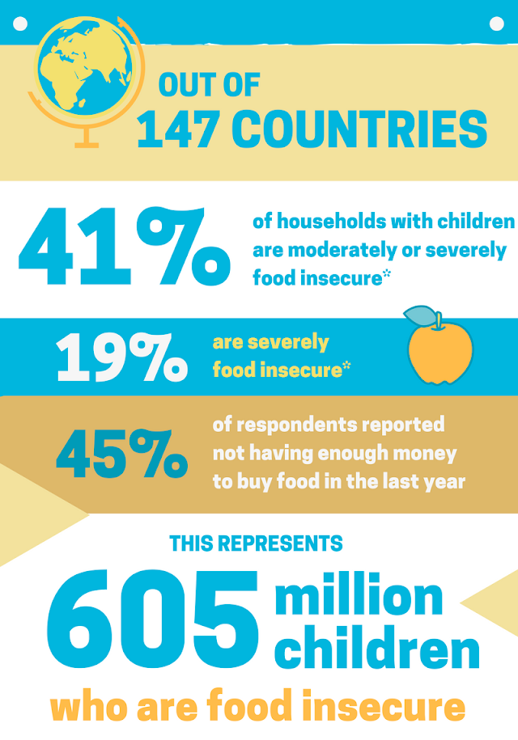
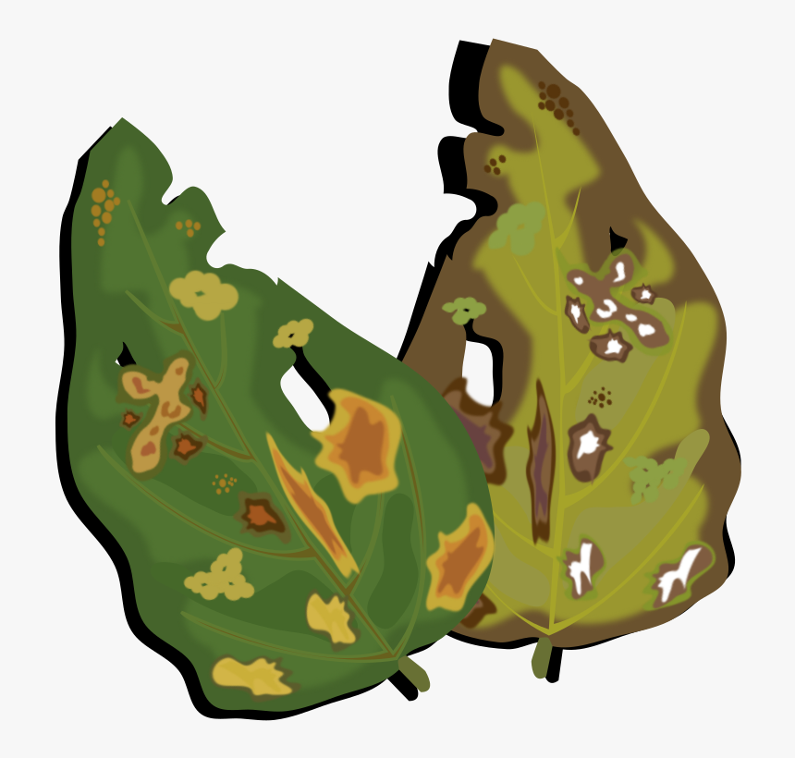
Problem
Problem: Food insecurity and crop instability.
If only there was a convenient & quick way for farmers and people to treat their crops…

Slide 4

Introduction (Background Research)
General Knowledge:
FAO estimates that annually between 20 to 40 percent of global crop production is lost
Each year, plant diseases cost the global economy around $220 billion
Coding knowledge:
Python for machine learning
fastai & Pytorch - deep learning library
Java for Android app development & Swift for iOS app development
Building a Flask Rest API in Python and hosting it using Amazon Web Services (AWS)

Slide 5
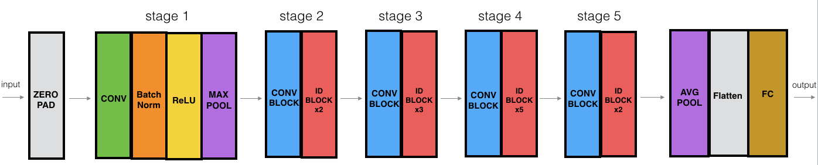
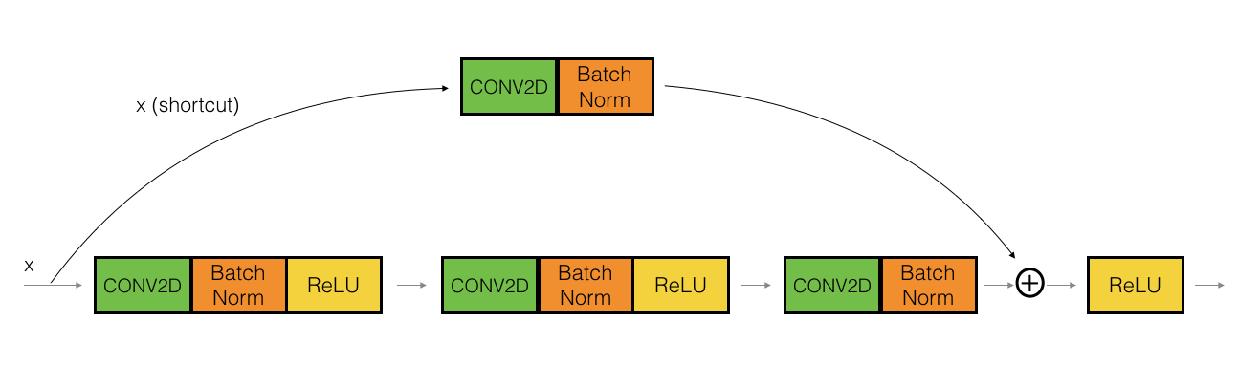
Hypothesis
ResNet-50 (Residual Network)
The power of convolutional neural networks (CNNs), specifically, ResNet-50 allows computer to detect patterns in the pixels of images that humans cannot see.
As opposed to other ResNet variants, ResNet-50 provides compromise of additional model layers (50) while keeping model storage relatively low (~100mb).
Finally, skip connections helps mitigate vanishing gradient and model performance will perform at least as good as previous layer.

Slide 6
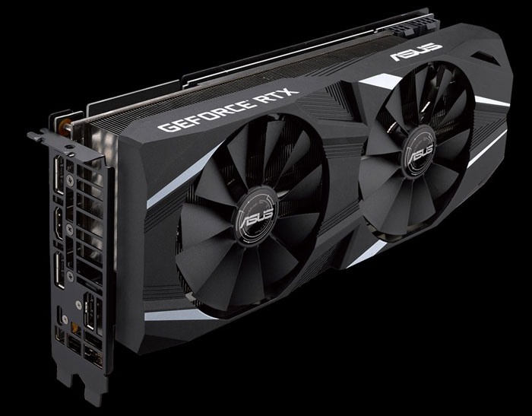

Materials
Computer Specs:
Intel Core i5-9600k processor
64gb of ram
500gb SSD
GeForce RTX 2070 Graphics Card (w/ 8GB GDDR6)
Operating System: Ubuntu 20.04 LTS

Slide 7
Procedure
Create image dataset using public image data of plant leaf diseases
Research information about best pretrained convolutional neural network (CNN) models for transfer learning
Train ResNet-50 CNN model for 20 epochs for each plant using fastai
Fine tune CNN models for more epochs by manipulating hyperparameters of model
Save CNN model and export model file
Write Rest Application Programming Interface (API) with Python Flask library
Host API with Amazon Web Services (AWS)
Write simple UI for image selection mobile application in Java and Swift
Connect mobile application to API in Java and Swift app
Deploy app in App Store and Google Play Store

Slide 8
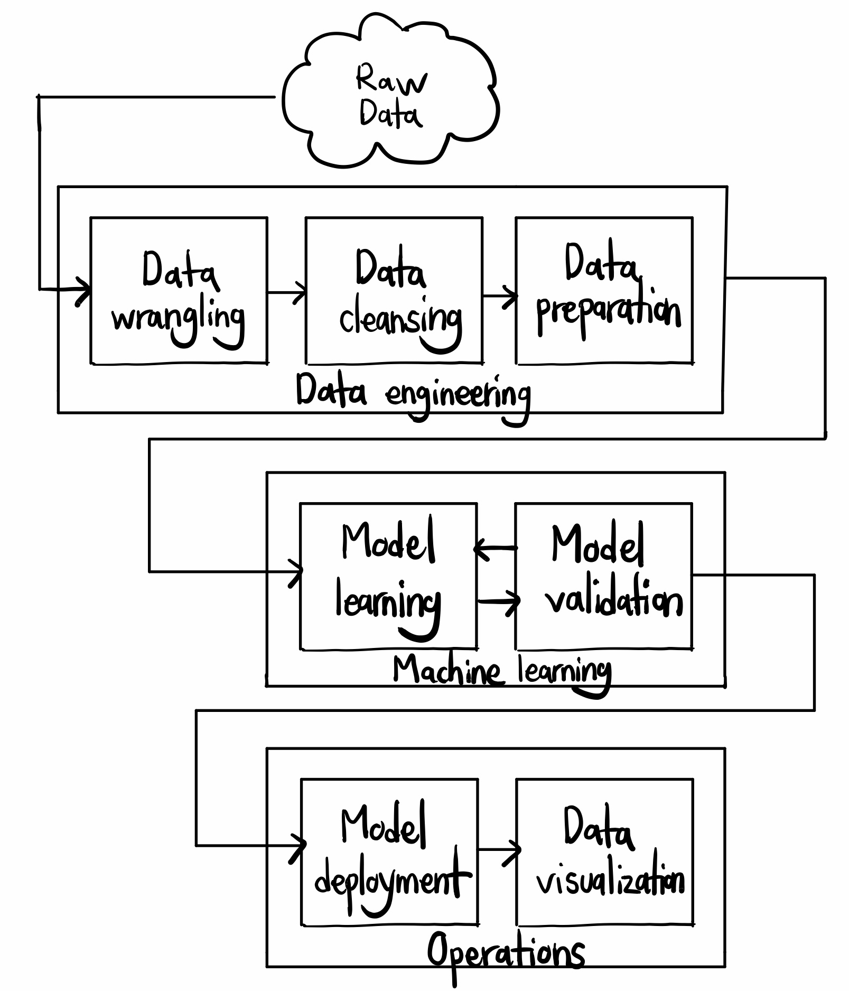
Procedure (Continued)

Slide 9
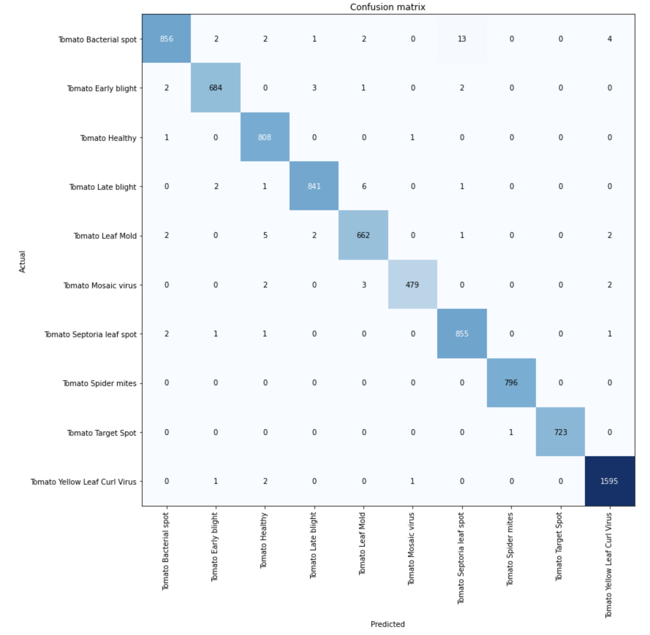
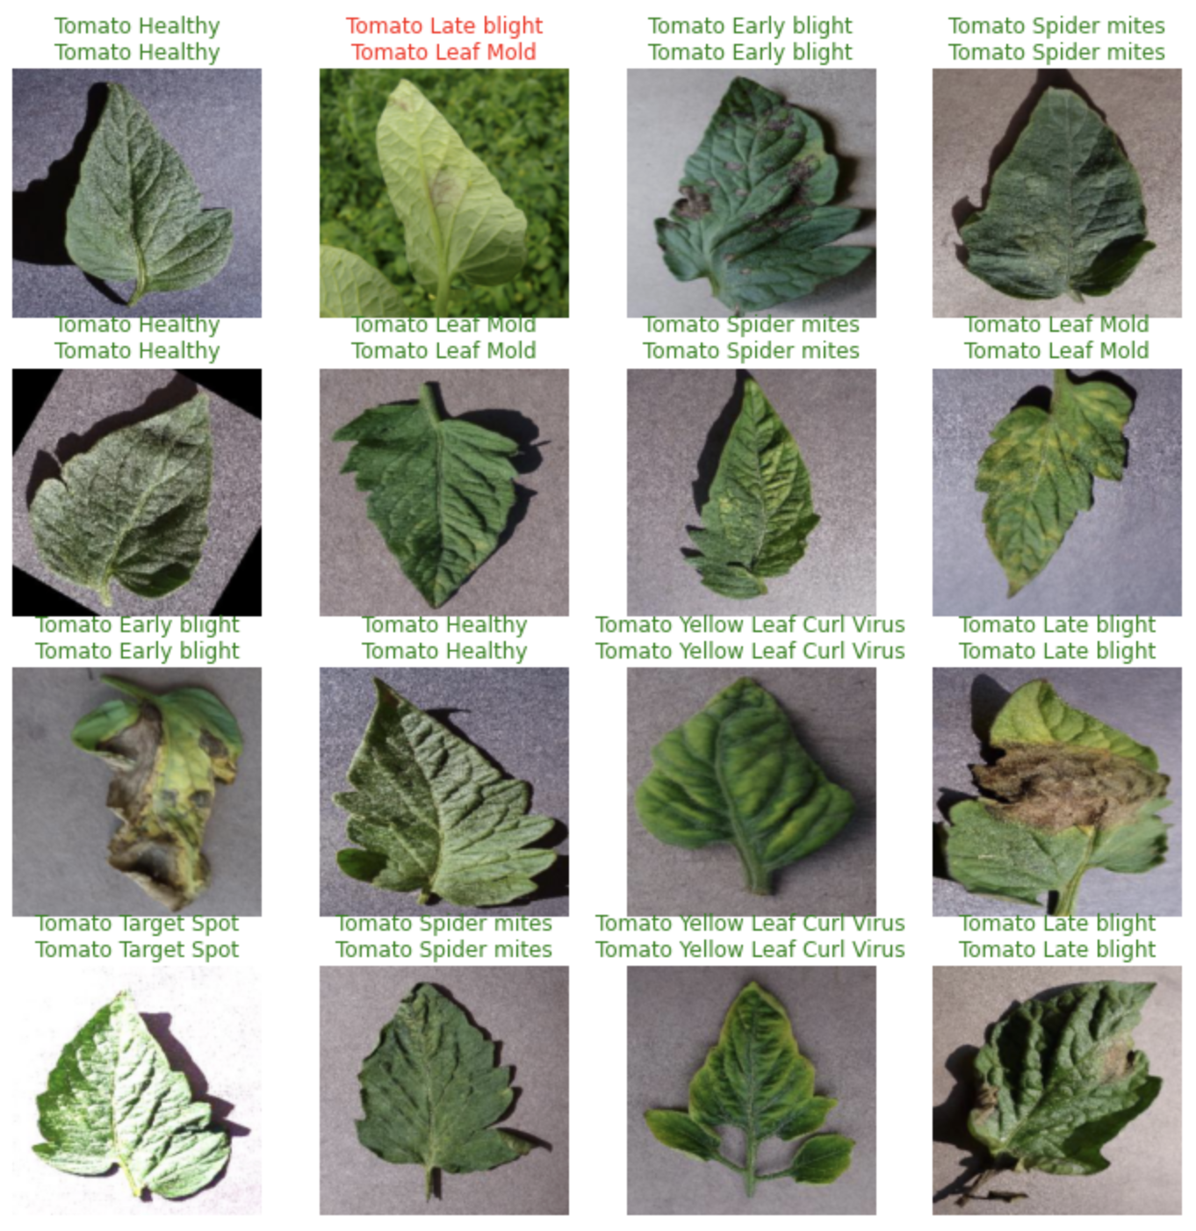
Results
Training confusion matrix
Prediction results on test batch
Results on test data batch
My final model for tomato leaf disease detection achieved a validation accuracy of 99.2%.

Slide 10
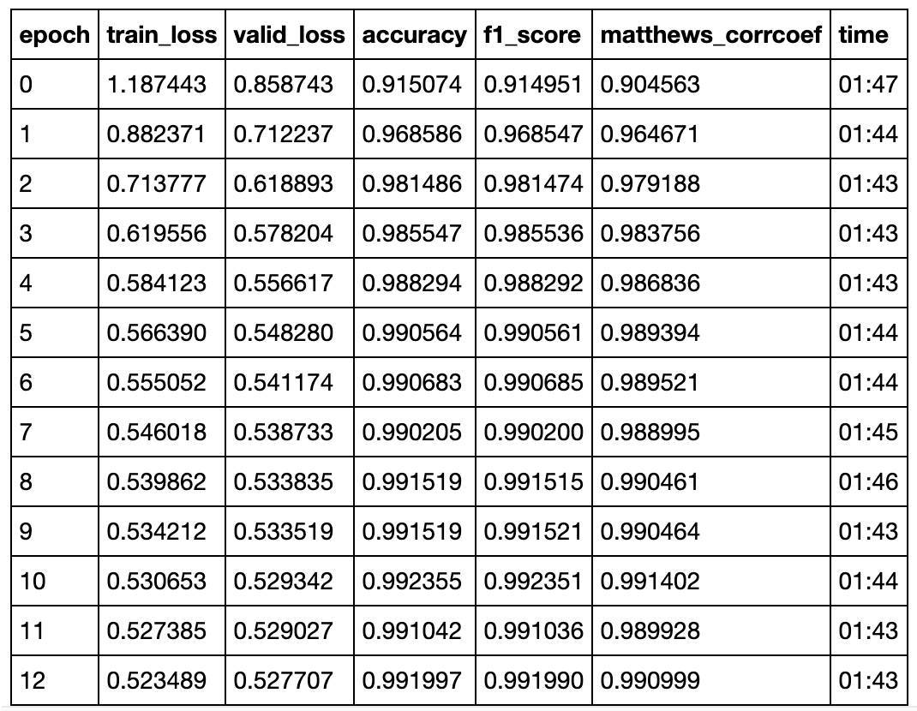
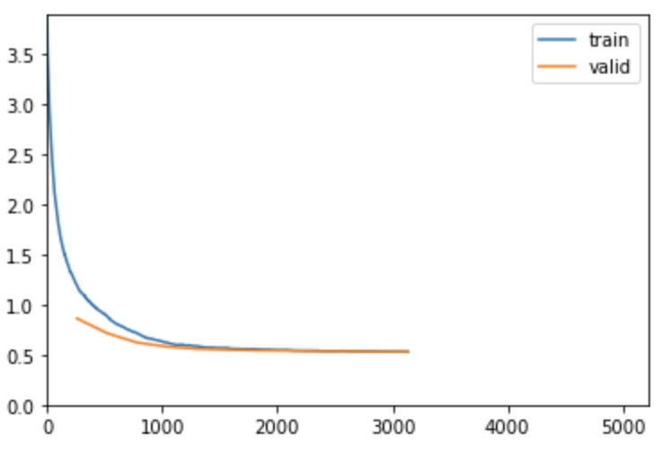
Discussion
Results shown below are for tomato leaves:
Training and Validation table
Epochs vs Training and Validation graph

Slide 11
Discussion
Analysis of important statistics used:
The Matthews correlation coefficient (MCC) is in essence a correlation coefficient value between -1 and +1 commonly used in machine learning that considers class imbalances. A coefficient of +1 represents a perfect prediction, 0 an average random prediction and -1 an inverse prediction. It takes into consideration true and false positives and negatives. My model achieved a MCC of 0.991.
The F1 score can be interpreted as a weighted average of the precision and recall, where an F1 score reaches its best value at 1 and worst score at 0. This is also helpful in considering class imbalances. My model achieved an F1 score of 0.992.
As shown in the train loss and valid loss columns and the Epochs vs Training and Validation graph my model has a good fit after 12 epochs of training
A good fit is identified by a training and validation loss that decreases to a point of stability with a minimal gap between the two final loss values.
Therefore, based on the previous statistics it can be inferred that the validation accuracy from my results is reliable to diagnose and treat plant diseases.
Points of improvement:
Some of my data can have a greater variety of diseases for each plant. For instance, due to lack of available public data, the strawberry and cherry plants only had two classes each. While other plants like tomatoes had 10 different disease classes.

Slide 12
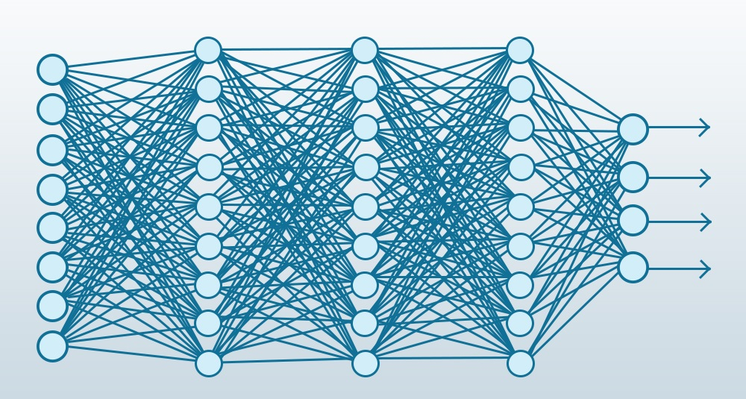
Conclusion
In summary, after my experiments, I found that using 2D convolutional neural networks (CNNs) is an effective way to simulate an expert’s advice and most importantly educate the public and farmers on ways to treat plant diseases to produce healthier crops.

Slide 13
Reflection/Application
In the future, I would like to add more plant types and diseases to my dataset. Additionally, I want to add more features like plant nutritional deficiency recognition which can help provide insight into pesticide free and biological treatment of plants. Finally, I would like to implement and experiment with more state-of-the art models including XResNet and its variants for transfer learning on different datasets. I have also made my findings and code online on GitHub open source to help others who want to pursue similar machine learning projects in the future. Something I might have done differently was build my app in React Native or Flutter as it would have allowed me to bundle my iOS and Android app together which would be easier to do as the only developer. Overall, I hope the public and farmers are able to effectively use my app to treat their plants.

Slide 14
References Cited
Brownlee, J. (2019, August 6). How to use Learning Curves to Diagnose Machine Learning Model Performance. Machine Learning Mastery. https://machinelearningmastery.com/learning-curves-for-diagnosing-machine-learning-model performance/.
Dwivedi, P. (2019, March 27). Understanding and Coding a ResNet in Keras. Medium. https://towardsdatascience.com/understanding-and-coding-a-resnet-in-keras- 446d7ff84d33#:~:text=ResNet%2C%20short%20for%20Residual%20Networks,of%20ImageNet%20challenge%20 in%202015.
He, K., Zhang, X., Ren, S., & Sun, J. (2016). Deep residual learning for image recognition. 2016 IEEE Conference on Computer Vision and Pattern Recognition (CVPR). https://doi.org/10.1109/cvpr.2016.90
He, T., Zhang, Z., Zhang, H., Zhang, Z., Xie, J., & Li, M. (2019). Bag of Tricks for Image Classification with Convolutional Neural Networks. 2019 IEEE/CVF Conference on Computer Vision and Pattern Recognition (CVPR). https://doi.org/10.1109/cvpr.2019.00065
Smith, L. N., & Topin, N. (2019). Super-convergence: very fast training of neural networks using large learning rates. Artificial Intelligence and Machine Learning for Multi-Domain Operations Applications. https://doi.org/10.1117/12.2520589

